Slide 1
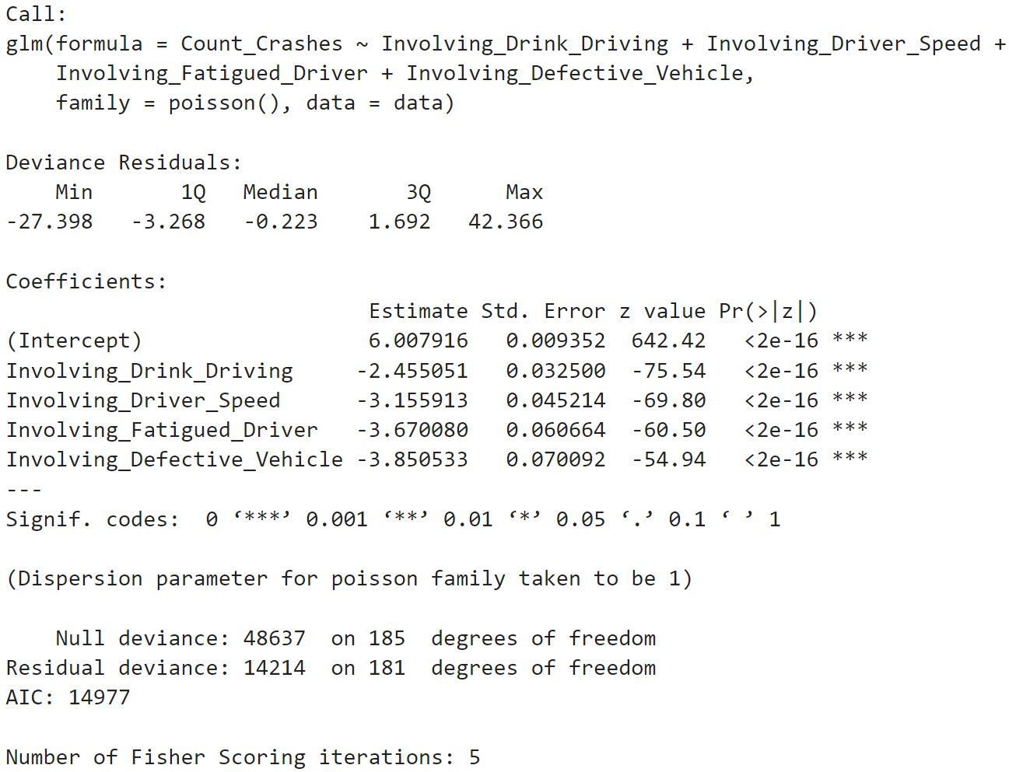
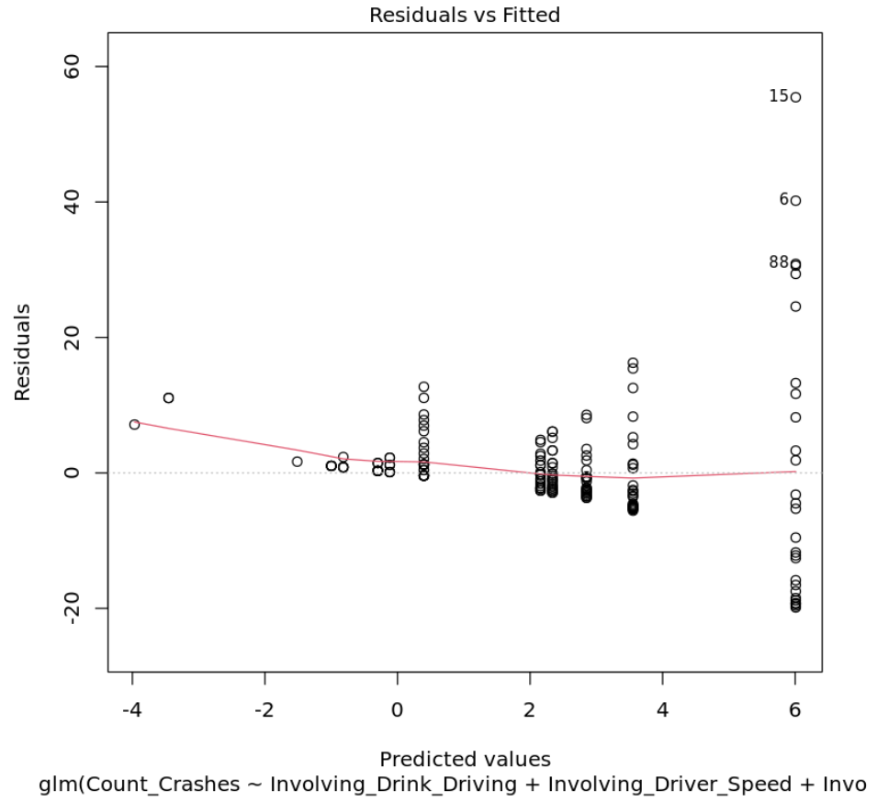
4.2 Poisson Regression for Analyzing Involvement Factors to Count of Crashes
Notes:
The results of the Poisson regression analysis suggest that Involving Drinking Driving, Involving Driver Speed, Involving Fatigued Driver, and Involving Defective Vehicle are all significant predictors of the count of crashes. These variables can explain some, but not all, of the variability in the count of crashes. Additionally, there appears to be a linear relationship between the combination of these four variables and the occurrence of car accidents. As the occurrences of these situations increase, the probability of a car accident also increases. The red line in the graph illustrates this linear relationship between these situations and the number of car accidents. Overall, these findings provide important insights into the factors that contribute to car accidents, and can inform strategies for reducing the occurrence of car accidents on the road

Slide 2
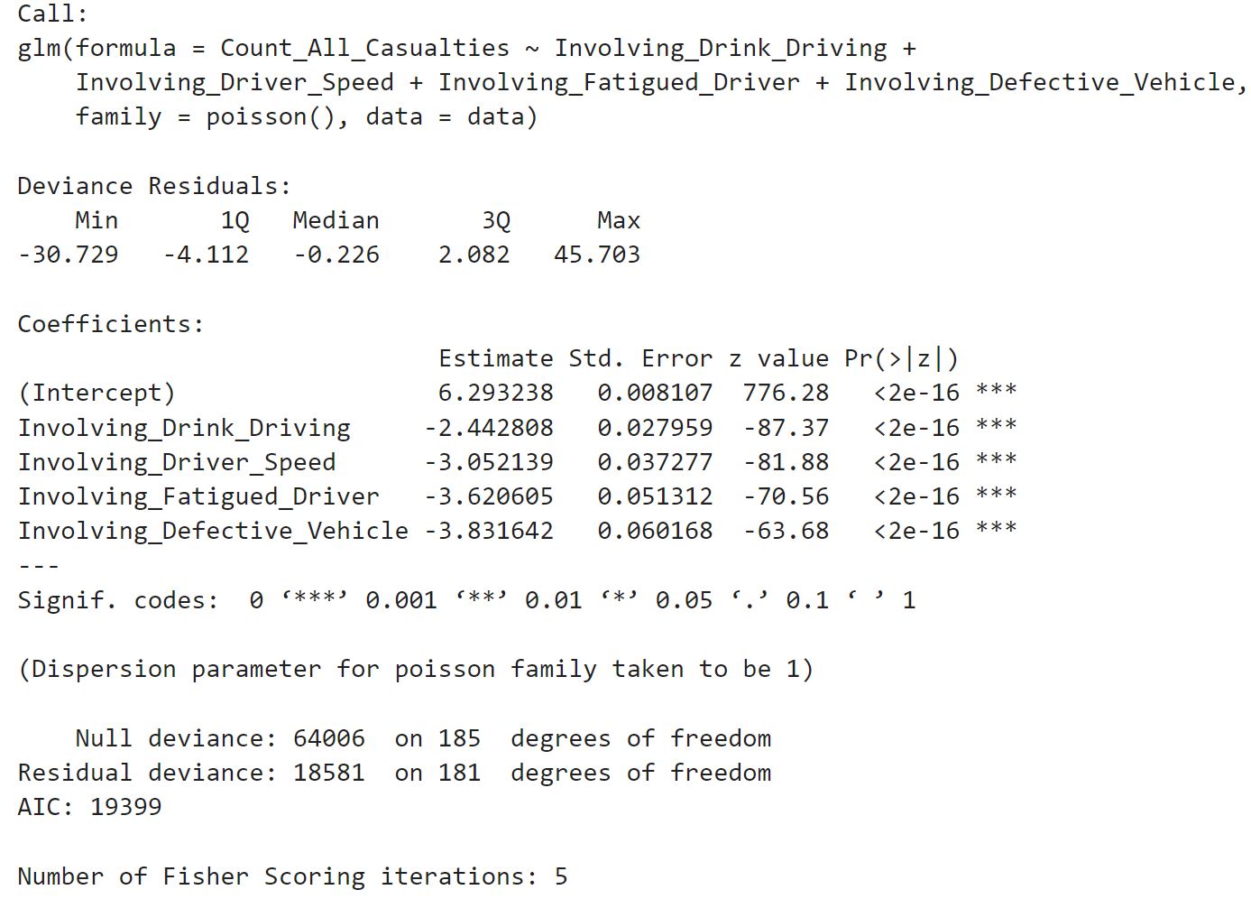
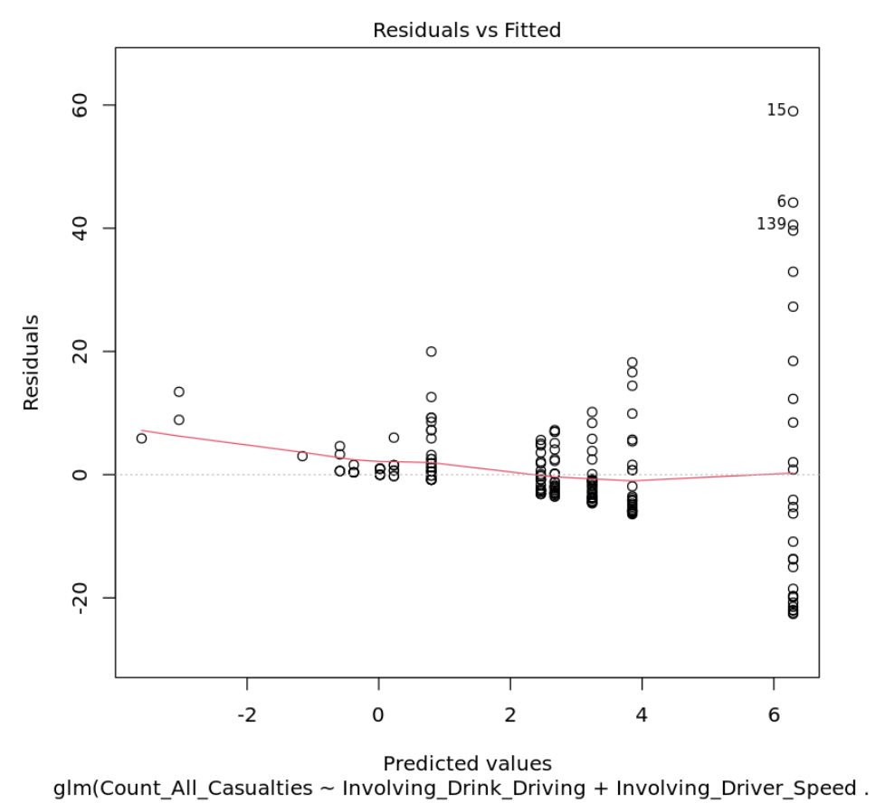
4.2Poisson Regression for Analyzing Involvement Factors to Count of Casualties
Notes:
The results of the model indicate that involving driving while under the influence of alcohol, speeding, driving while fatigued, and driving a defective vehicle are all significant predictors of the count of all casualties in car accidents. However, the model does not explain all of the variability in the count of casualties. Additionally, the model suggests that there is a linear relationship between the combination of these four variables and the occurrence of casualties. As the occurrences of these situations increase, the probability of casualties also increases, and this relationship is demonstrated by the red line in the graph. Overall, these findings can help to inform efforts to reduce the occurrence of car accidents and associated casualties.

